Slide 1

Apsit Student Club
Jateen Tirlotkar 20104091
Devesh Zope 20104086
Sahil Vishwakarma 20104089
Siddhesh Sawant 20104044
Project Guide
Ms. Roshana Sangle

Slide 2
Contents
Introduction
Objectives
Scope
Features / Functionality
Project Outcomes
Technology Stack
Block Diagram if applicable
Reference

Slide 3
1. Introduction
Problem Identified :
  While doing studies or projects we often get distracted while discussing with our group through social media apps.
Solution Proposed :
  This Students Club Helps students to discuss with their group cool utilities which are useful for their project.

Slide 4
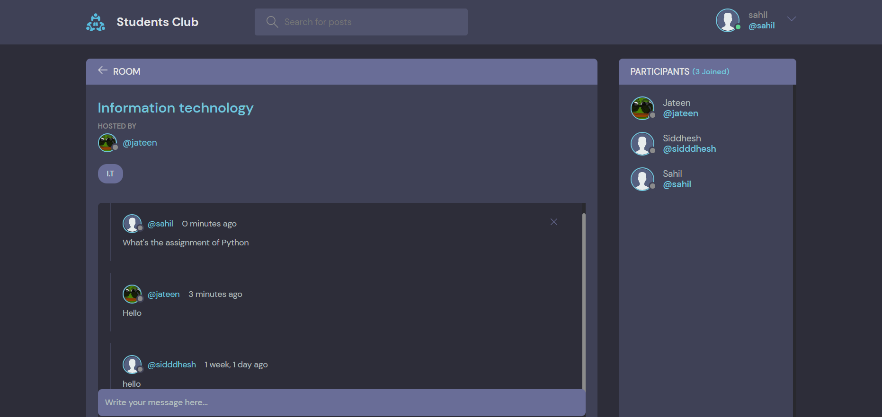
2. Objectives
To build a user-friendly platform to chat with group members.
To avoid errors while sharing our code with group members
It can assist the Students to concentrate on their development rather than concentrate on the record-keeping.
To allow users to connect to chat servers and communicate with other users via chat room

Slide 5

3. Scope
Students Club is an integrated Web-app developed for students to chat with each other about their Studies, Assignments, and their work like a Normal chat Application.
We will see the entire system more interactive and try to bridge between user and developer.
3. It has a Blog Section which shows the best technical blogs written by students.
4. The utility section will have more options and content with the help of the feedback section.

Slide 6
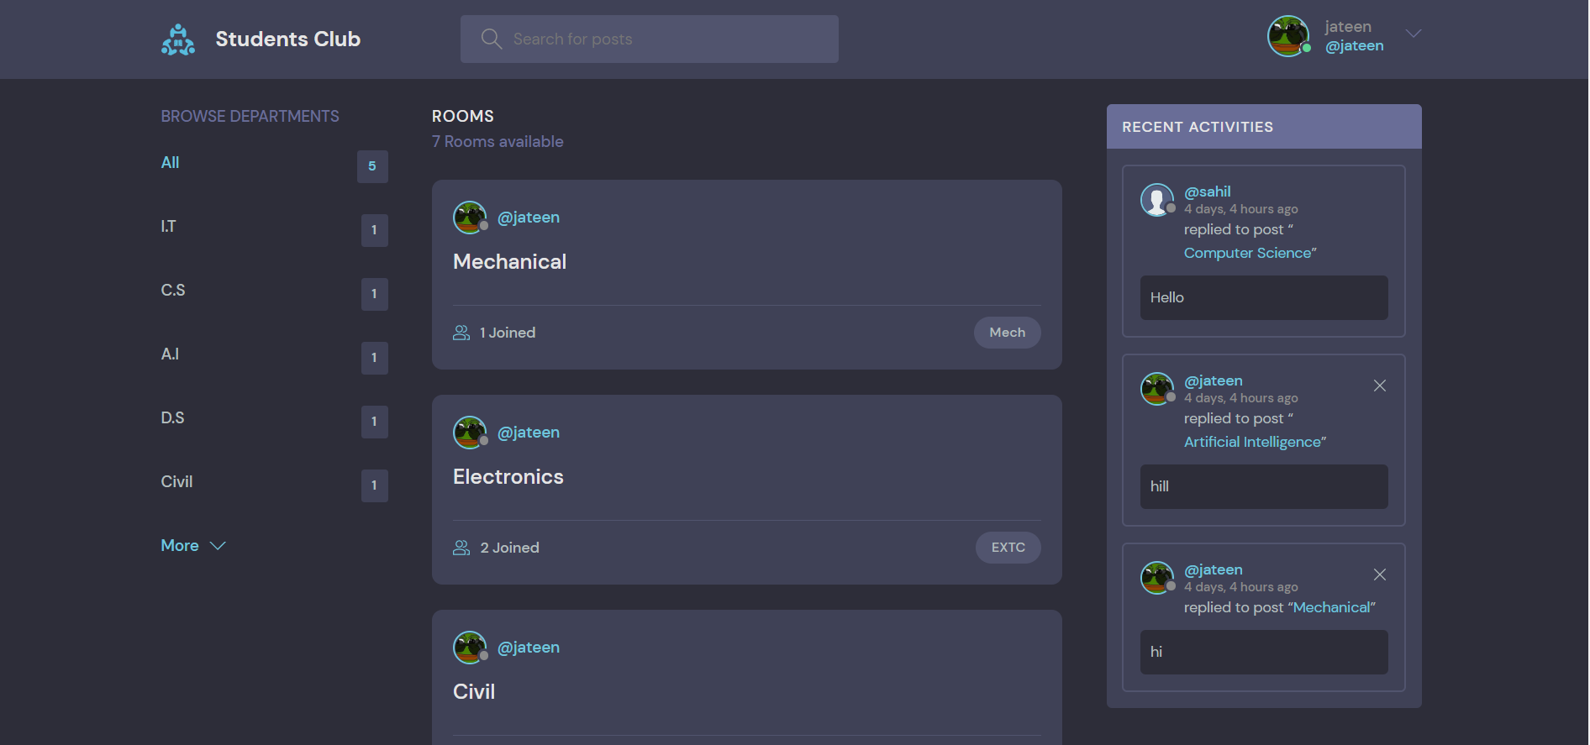
4. Feature /Functionality
User-friendly Interface :
A well-organized user interface makes it easy to locate different tools & options that our system excels at.
2. Communication & time management :
Deployment of our application will certainly help the college to reduce unnecessary wastage of time in personally going to each department for some information during this covid time.
Gaming & Blog :
To make it more enjoyable gaming will help to reduce their stress and the blog will make the most of the time knowledgeable.

Slide 7
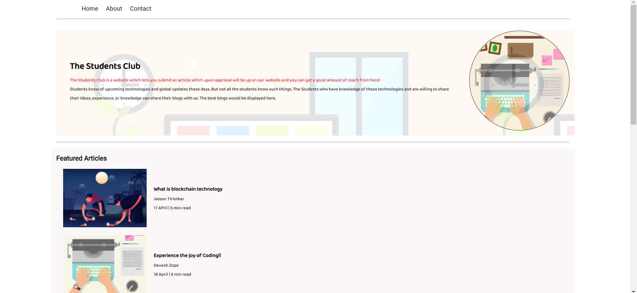
5. Outcome of Project
User Can log in after they have registered with the correct information.
Users can go to their respective rooms according to their branches.
Users can live chat with their colleagues on our interactive platform.
Users can play games and enjoy their reading time on our blog site.
5. We can add new features as and when we require them.

Slide 8
6. Technology Stack
Frontend:
Visual Studio Code
Python 3.10
Framework Used: Django
Backend:
Database Used: MySqlite3

Slide 9
7. Block Diagram
Register
Login
EXTC
A.I
I.T
C.S
Civil
mech
D.S
Chat
Blog
Games

Slide 10
Reference
https://youtu.be/rHux0gMZ3Eg
https://youtu.be/WVOmmc0UTiM
https://www.w3schools.com
https://www.slideshare.net/

Slide 11
Thank You...!!

